Slide 1
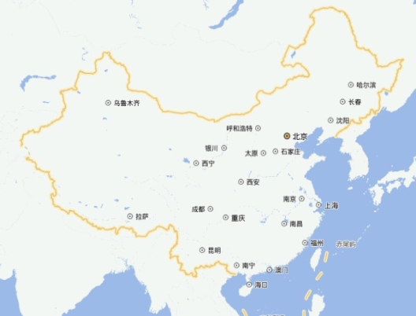
Mass predictions for neutron-rich nuclei and super-heavy nuclei
Ning Wang¹, Min Liu¹, Xi-Zhen Wu², Jie Meng^{3,4}
1 Guangxi Normal University, Guilin, China
2 China Institute of Atomic Energy, Beijing, China
3 Peking University, Beijing, China
4 Beihang University, Beijing, China
Origin of Elements and Cosmic Evolution:
From Big-Bang to Supernovae and Mergers
Nov. 27 -- 29, 2019, Beijing

Slide 2
Outline
Introduction
Weizsäcker-Skyrme mass model
Tests and model uncertainties
Influence of symmetry energy coefficients
Shell effects for nuclei with sub-shell closure
Summary and discussions

Slide 3
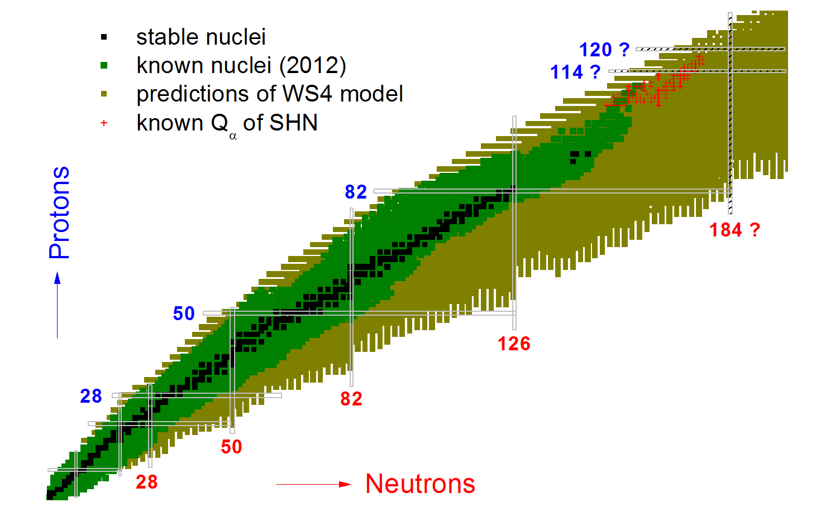

~ 2500 measured masses
~ 4500 unknown masses
Neutrons
…
fission
astrophysics
SHE
E_{sym}
mass
rms error of 200 keV ~ 1000 keV

Slide 4
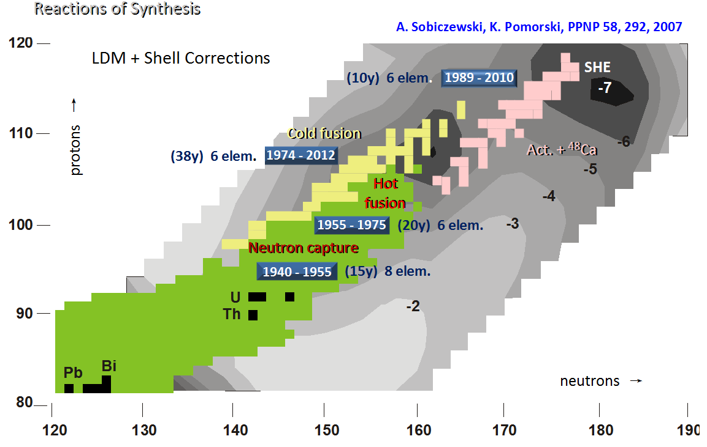
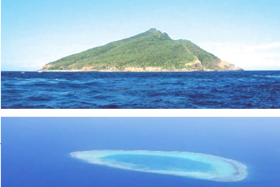
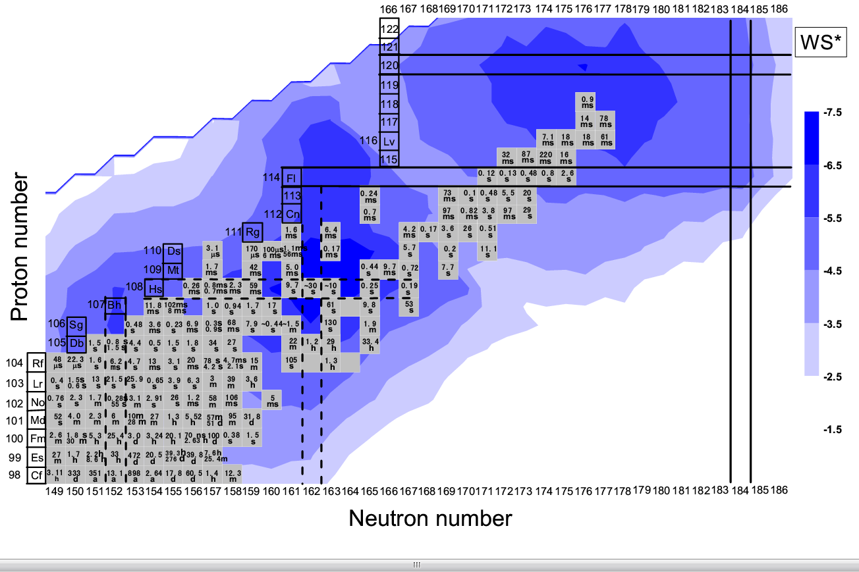
Super-heavy island or shoal?
neutrons →
Yu. Oganessian. SKLTP/CAS - BLTP/JINR July 16, 2014, Dubna
Does the SH island exist?
Where is the center?
N. Wang, Z. Liang, M. Liu, X. Wu,
Phys. Rev. C 82 (2010) 044304
Courtesy of Qiu-Hong Mo

Slide 5
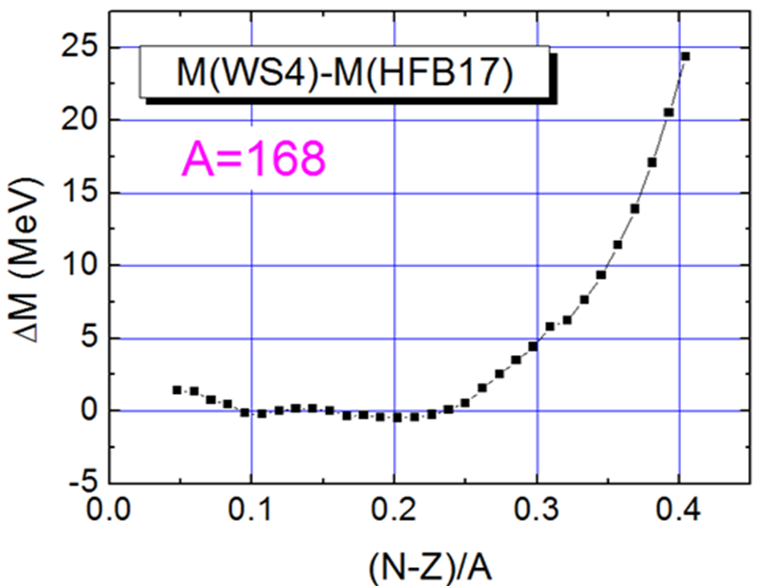
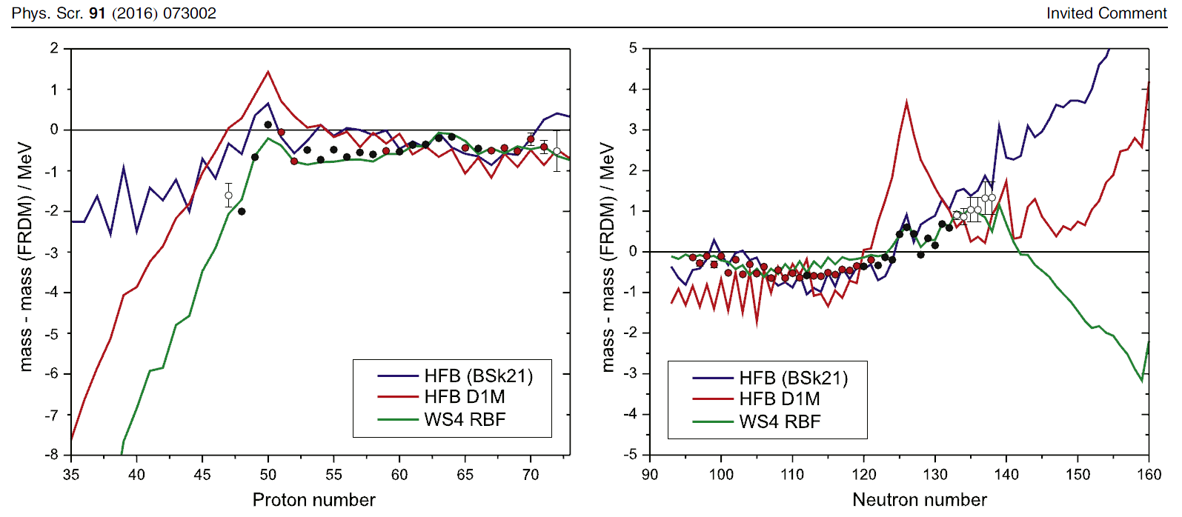
Discrepancies increase evidently approaching neutron drip line
What is the reason?
Y.-H. Zhang, Yu. A. Litvinov, T. Uesaka and H.-S. Xu
N=82
Z=82

Slide 6
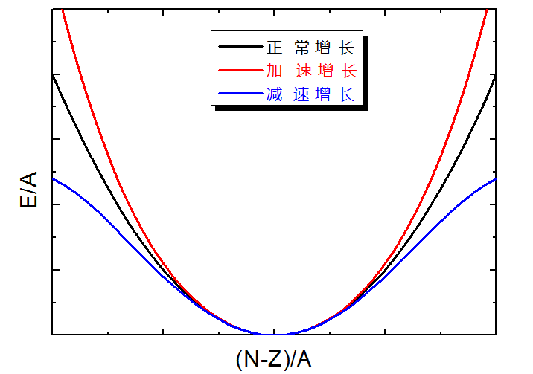

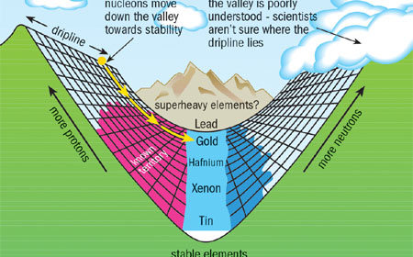

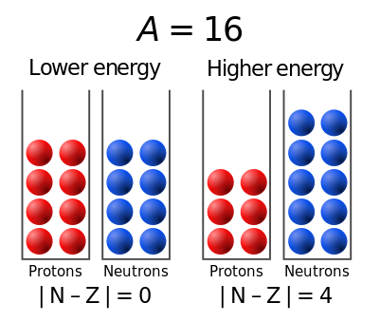
Symmetry energy coefficients
Normal
Accelerating
Decelerative
Parabolic law for drip line nuclei?
From Wikipedia

Slide 7
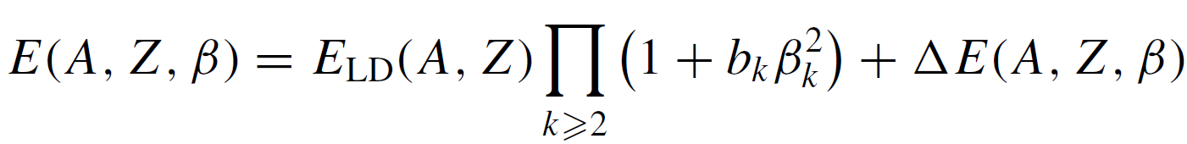
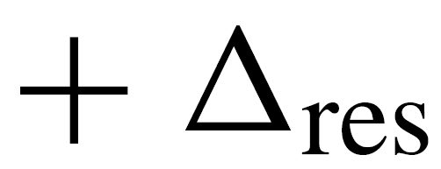
Weizsäcker-Skyrme mass model
Liquid drop
Deformation
Shell
Residual
Residual：Mirror 、pairing 、Wigner corrections...
Macro-micro concept & Skyrme energy density functional
N. Wang, M. Liu, et al., PRC81-044322；PRC82-044304；PRC84-014333

Slide 8
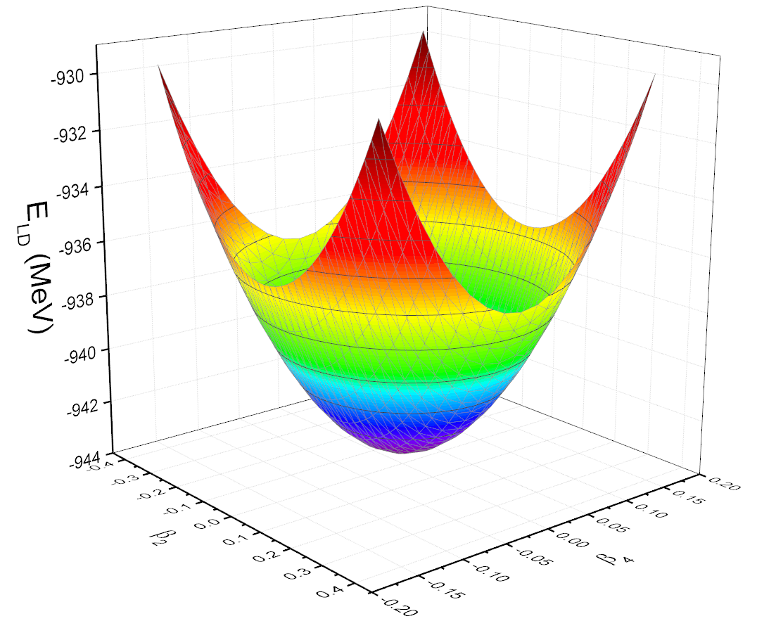
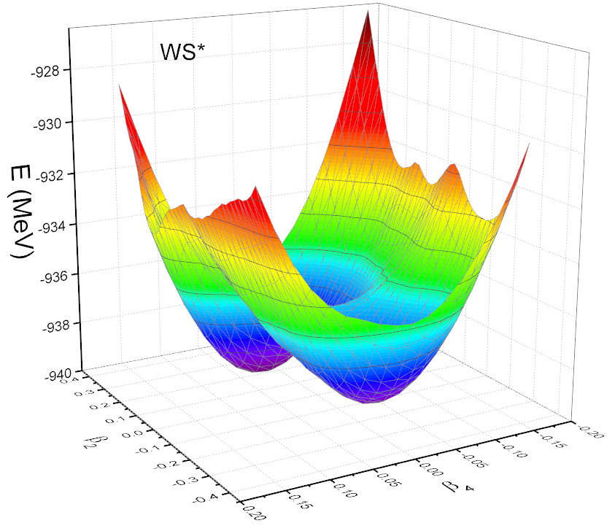
Potential energy surface
Liquid drop part
with shell corrections
¹¹⁰Pd

Slide 9



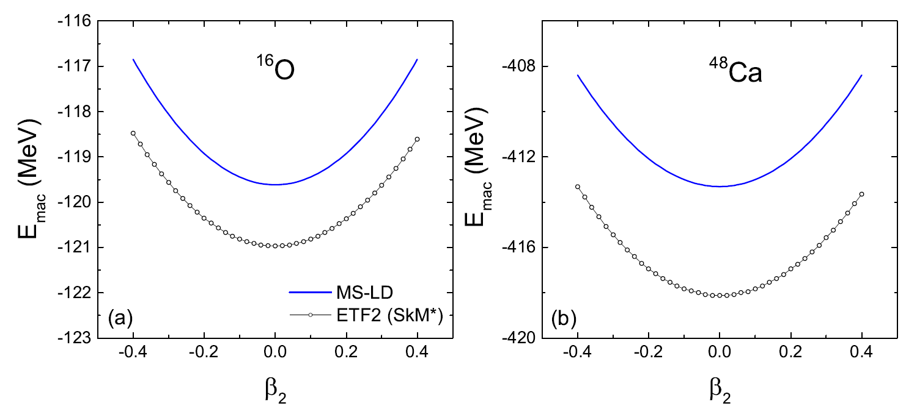
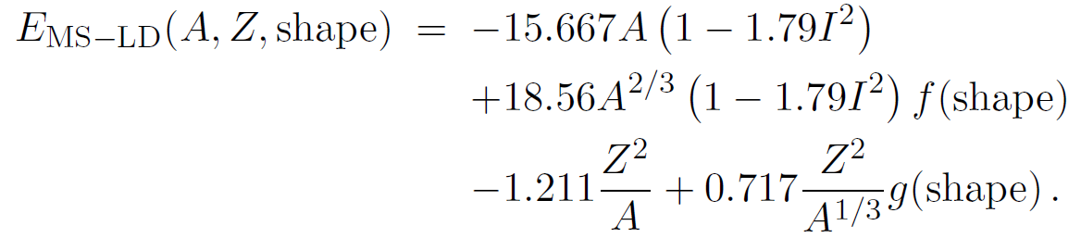
Parabolic approximation for the macroscopic potential energies
Myers, Swiatecki, Nucl. Phys. 81 (1966) 1
N. Wang, Tao Li, Acta Phys. Polo. B. 12 (2019) 715

Slide 10
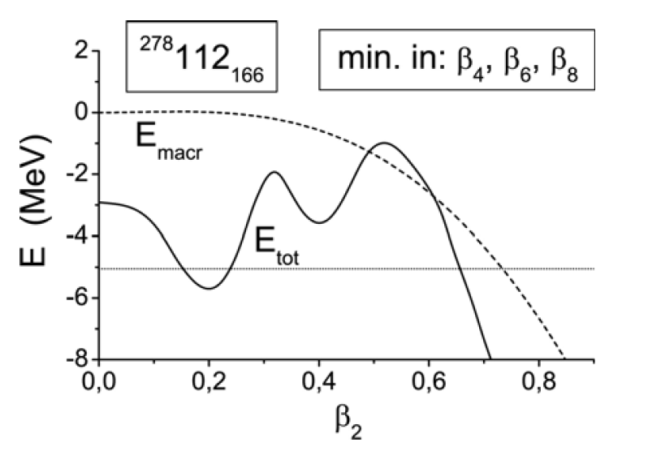
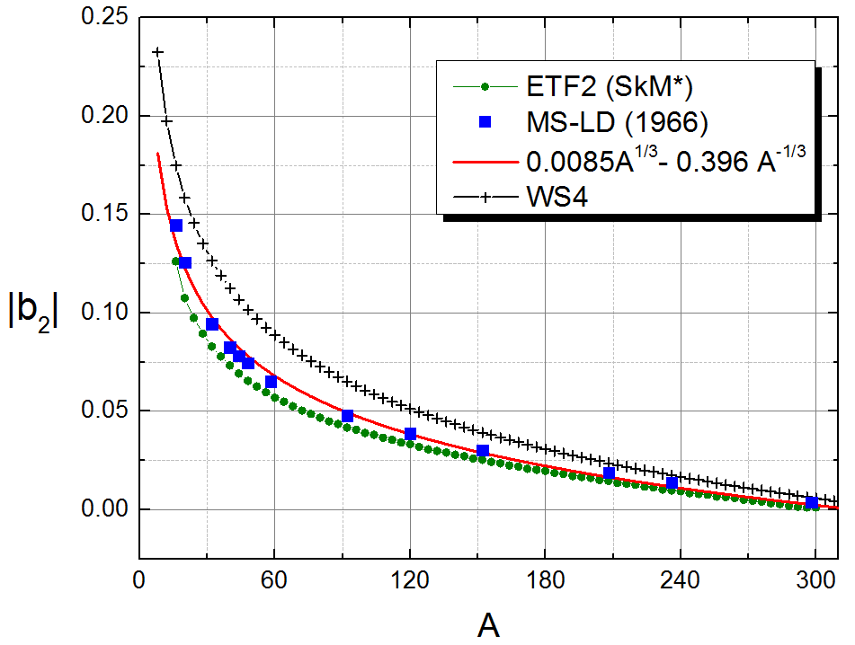
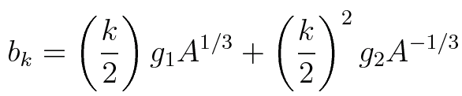
Sobiczewski, Pomorski, Prog. Part. Nucl. Phys. 58 (2007) 292
For super-heavy nuclei, the macroscopic fission barriers disappear in general, b_{k} → 0

Slide 11
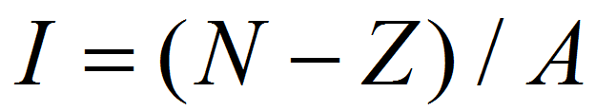
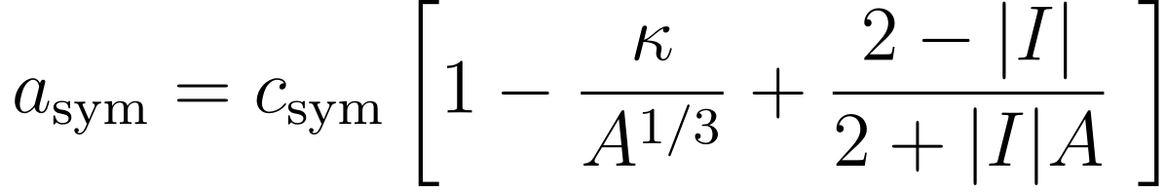


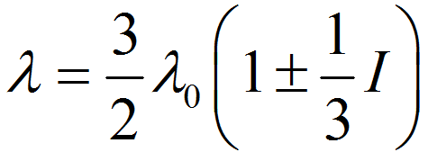
Isospin dependence of model parameters
Symmetry energy coefficient
Symmetry potential
Strength of spin-orbit potential
symmetry potential

Slide 12
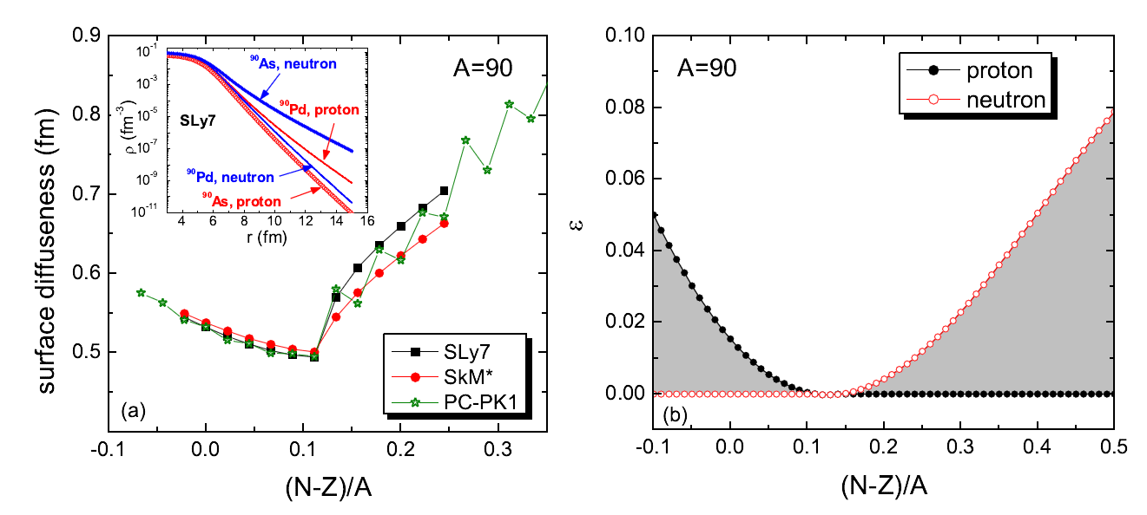
4. Surface diffuseness of the WS potential
Neutron-rich
N. Wang, M. Liu, X. Z. Wu, and J. Meng, Phys. Lett. B 734 (2014) 215

Slide 13

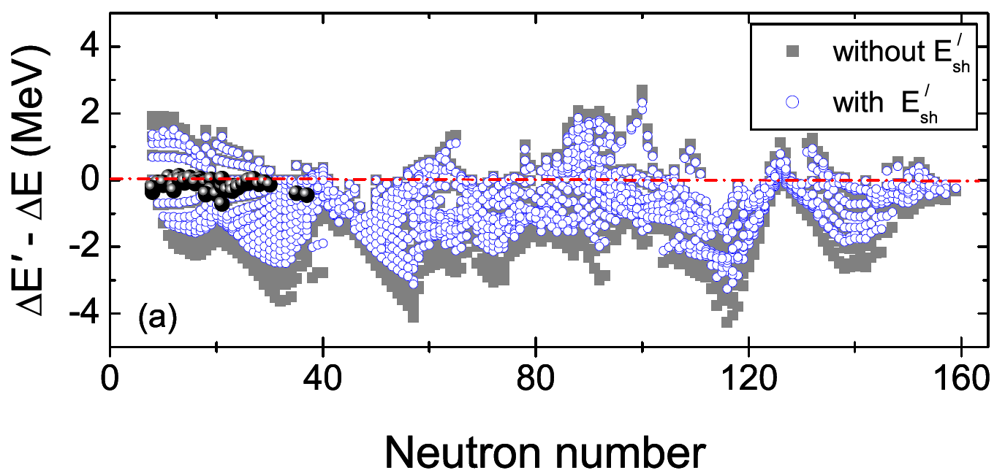



Consideration of isospin symmetry
Mirror Constraint from isospin symmetry
reduces rms error by ~10%

Slide 14
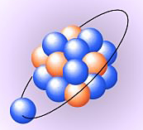

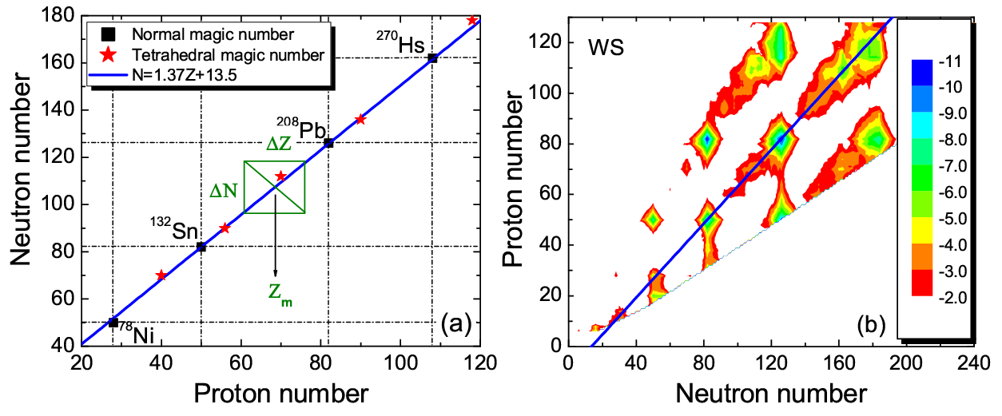


Wigner effect of heavy nuclei
Isospin symmetry between valence nucleons
(N,Z)
N=Z
K. Mazurek, J. Dudek，et al., J. Phys. Conf. Seri. 205 (2010) 012034

Slide 15
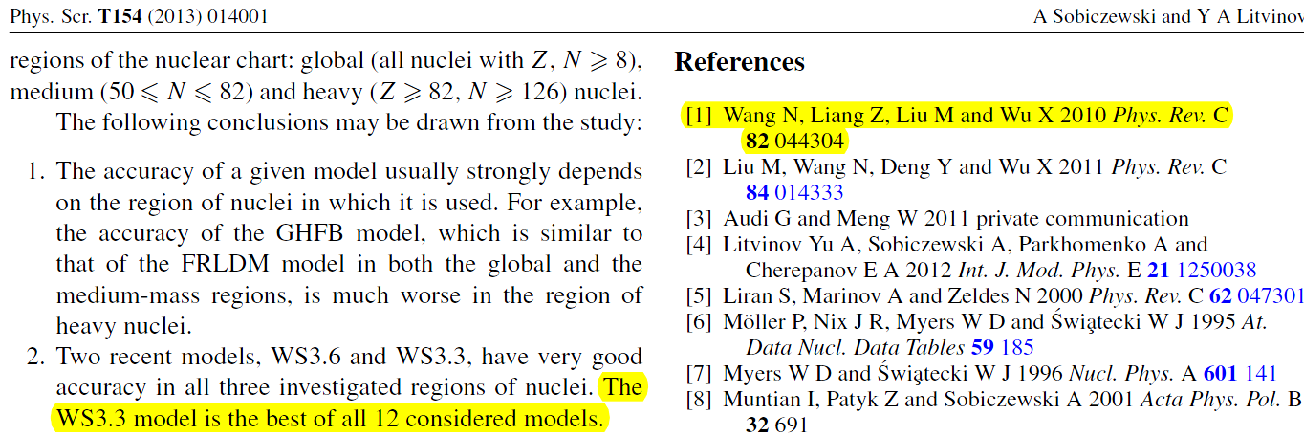
Tests and model uncertainties
with masses at different regions

Slide 16
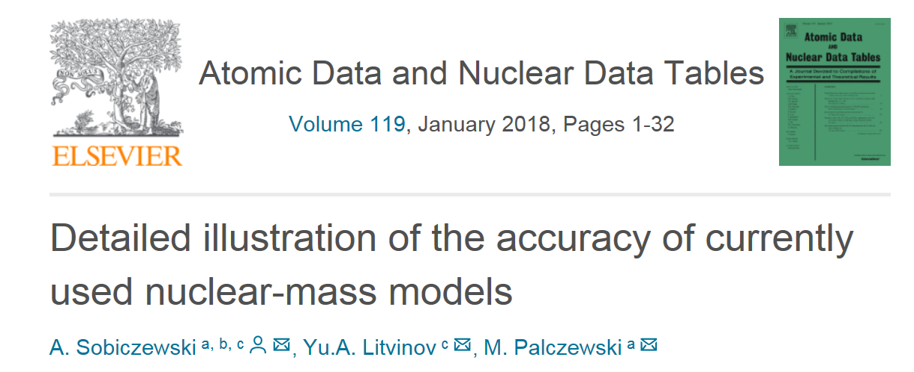
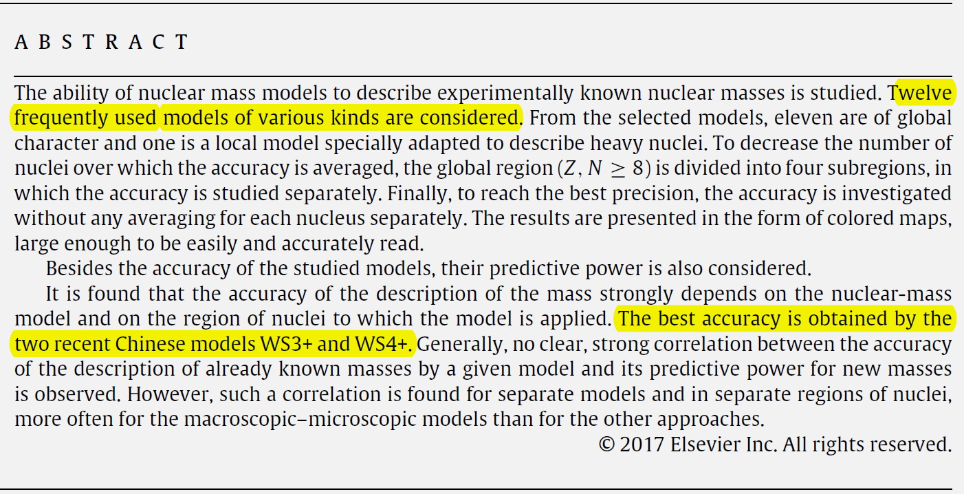
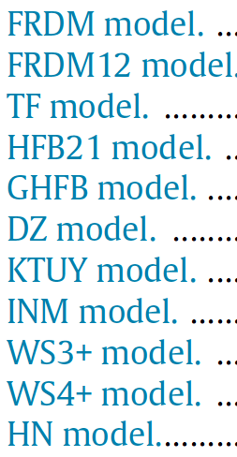
4 years later, with more data
LSD model …

Slide 17
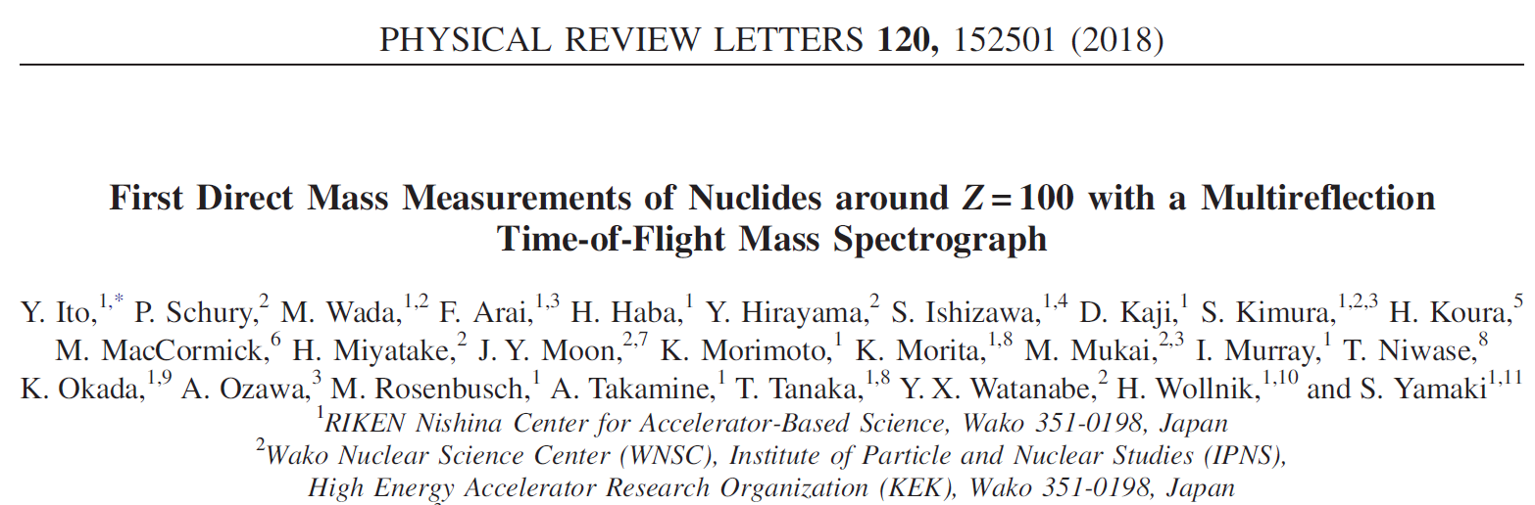
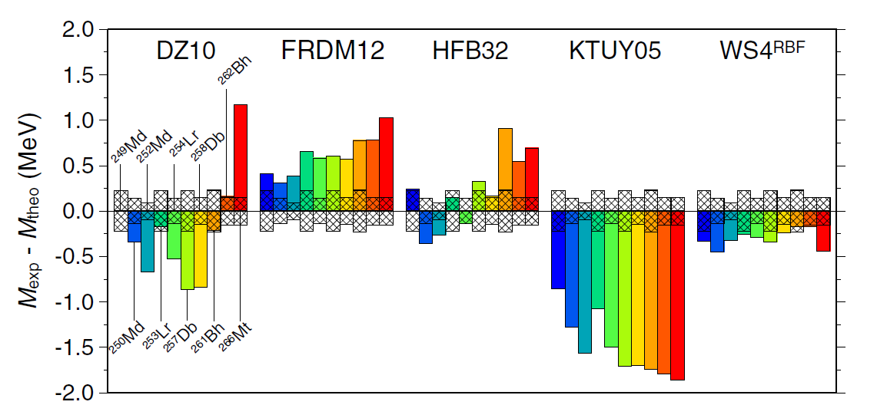
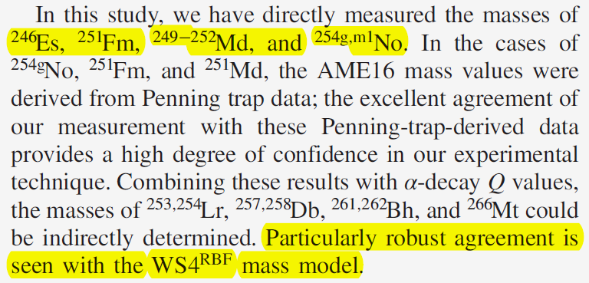

Slide 18
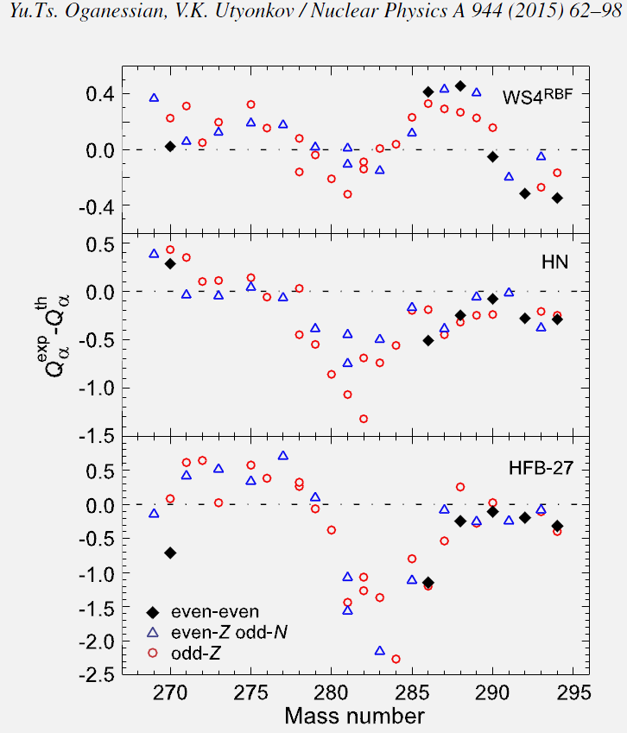
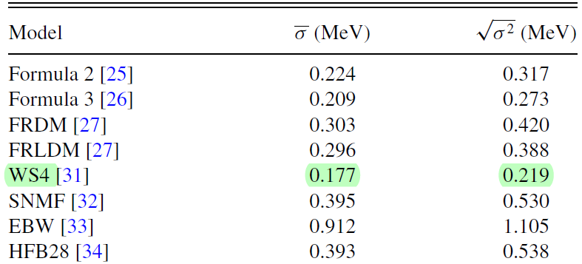
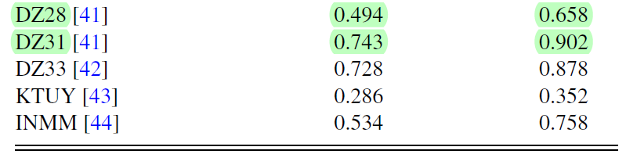
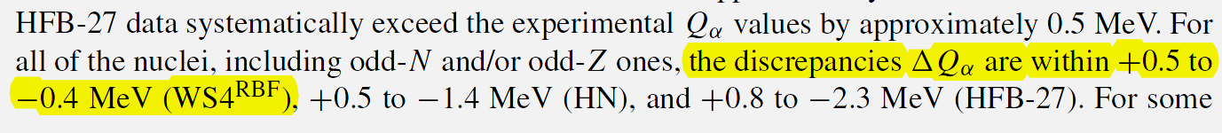
alpha-decay energies of SHN
to the data of 121 nuclei with Z>100
Y. Z. Wang, et al., Phys. Rev. C92,064301(2015)

Slide 19
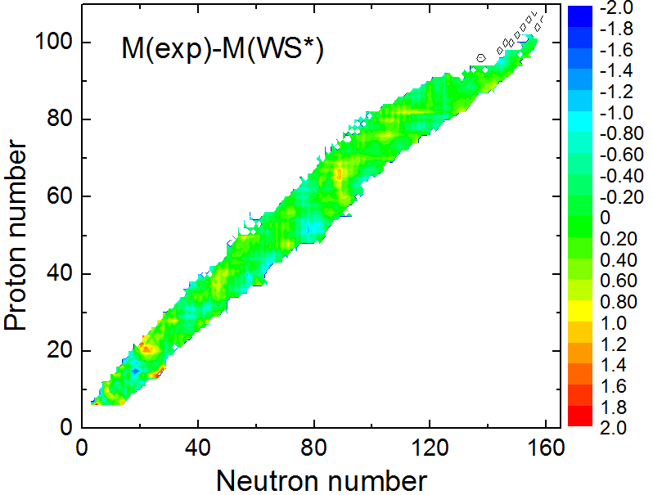
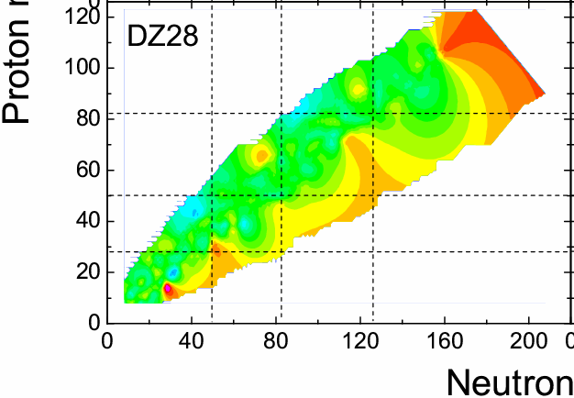

Predictive power for extremely unstable nuclei
rms err. (keV) | WS* | FRDM | DZ28
Year | 2010 | 1995 | 1995
AME2003 | 441 | 656 | 360
270 new data in AME2016 | 589 | 901 | 763
RBF correction
N. Wang and M. Liu, J. Phys: Conf. Seri. 420 (2013) 012057

Slide 20
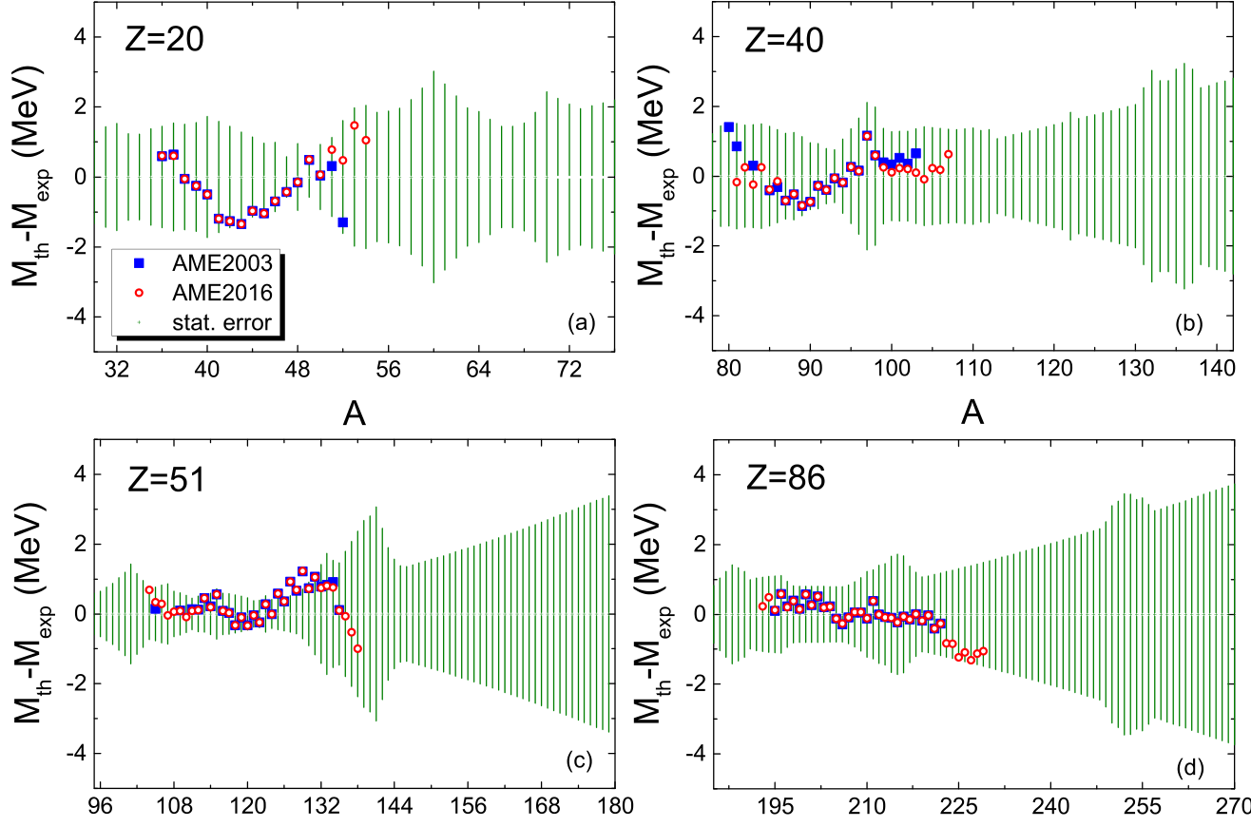
Statistical errors based on variation of fit data (WS*)
M. Liu, et al., Chin. Phys. C 41 (2017) 114101

Slide 21
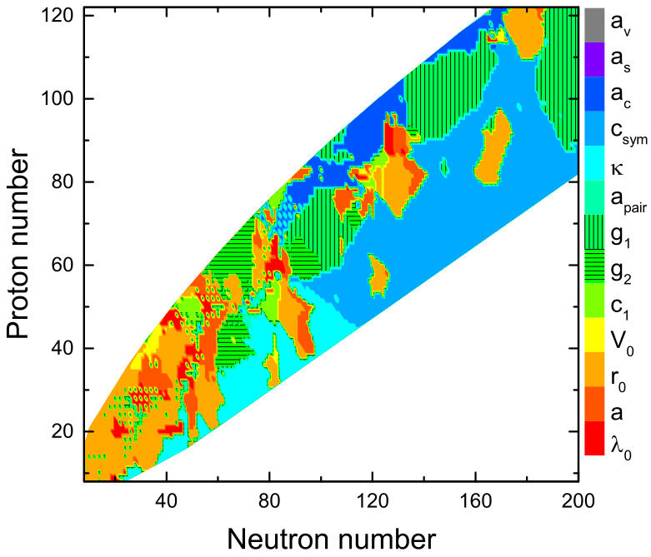
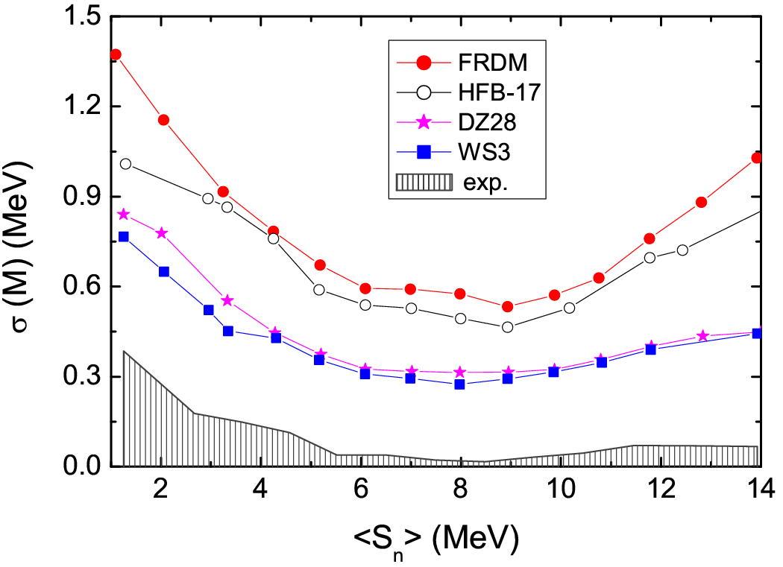

Most sensitive parameter
Neutron drip line

Slide 22
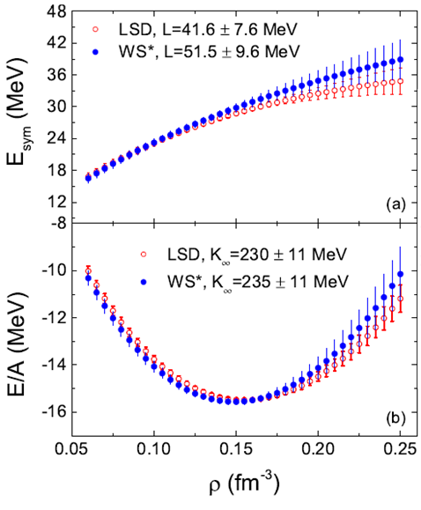
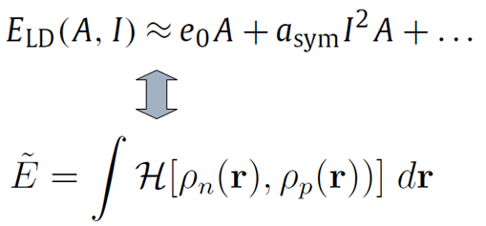
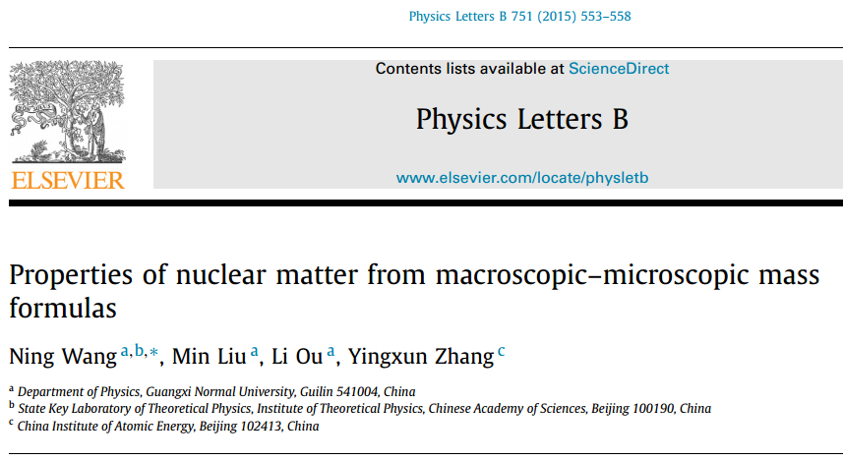
Influence of symmetry energy coefficients
Matching macro-micro model and Skyrme EDF

Slide 23
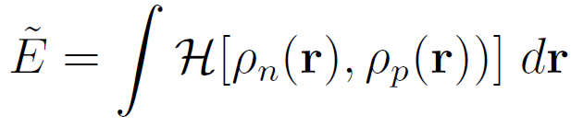
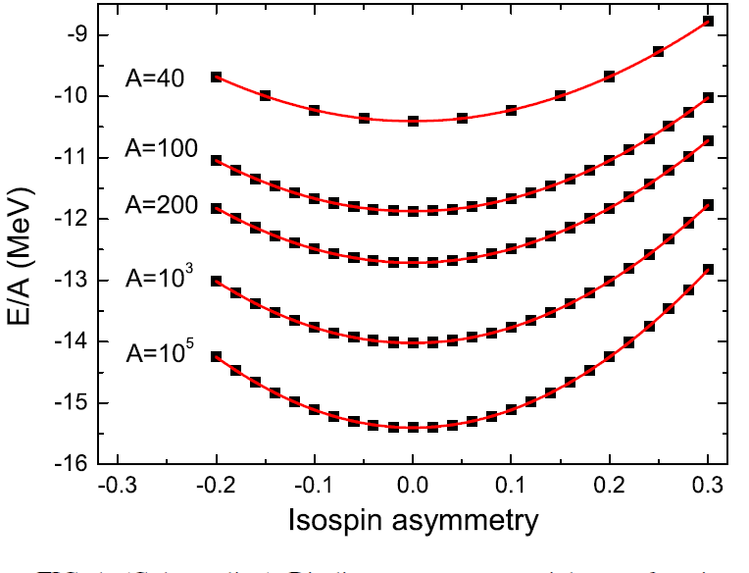
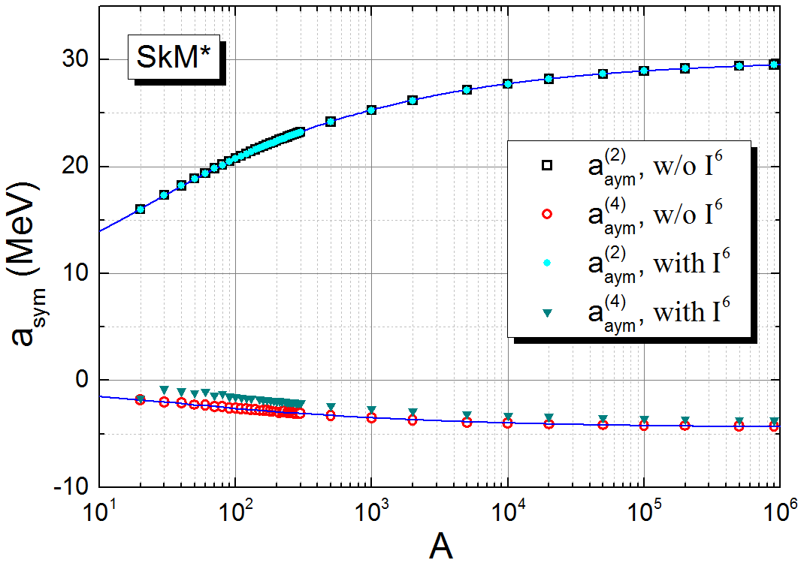
a_{sym} from Skyrme energy density functional + ETF2
Second-order
Fourth-order
N. Wang, M. Liu, H. Jiang, J. L. Tian, Y. M. Zhao, Phys. Rev. C 91(2015) 044308

Slide 24
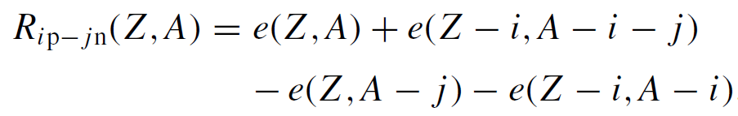
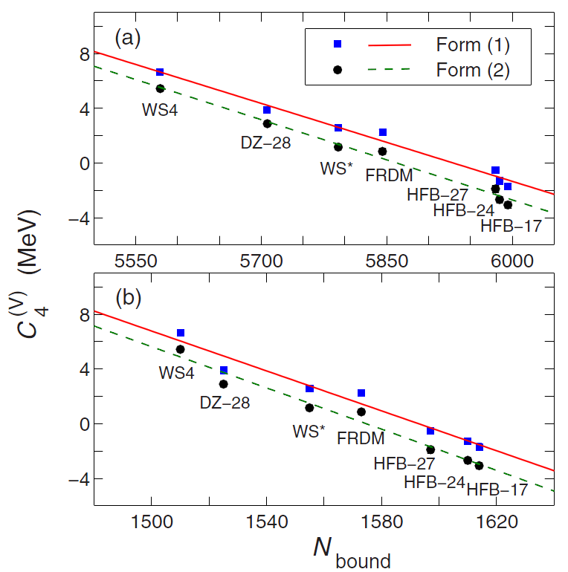




4th-order symmetry energy coefficient
Niu Wan, C. Xu, Z. Ren, J. Liu, Phys. Rev. C 97 (2018) 051302R
H. Jiang, N. Wang, et al.,
PRC 91 (2015) 054302
N_{bound}

Slide 25





4th-order symmetry energy coefficient
WS4
after removing Coulomb term, Wigner term & a_{sym}
HFB17
N. Wang, M. Liu, H. Jiang, J. L. Tian, Y. M. Zhao, Phys. Rev. C 91(2015) 044308

Slide 26


Shell effects for nuclei with sub-shell closure
Black squares denote spherical nuclei
WS4
N. Wang, M. Liu, X. Z. Wu and J. Meng, Phys. Rev. C 93, 014302 (2016)

Slide 27




Shell gaps
Wienholtz, et al.,
Nature 498 (2013) 346
Possible magic number N=32
N. Wang, M. Liu, Chin. Sci. Bull. 60, 1145 (2015)

Slide 28



Deformation energies
For nuclei along beta stability line
For nuclei along shell stability line N=1.37Z+13.5
N. Wang, Tao Li, Acta Phys. Polo. B. 12 (2019) 715

Slide 29


Deformations
Oblate
Prolate
Octopole

Slide 30



charge radii
N. Wang, T. Li, Phys. Rev. C88, 011301(R)

Slide 31


charge radii
Angeli, et al., J. Phys. G 42 (2015) 055108
N. Wang, Tao Li, Acta Phys. Polo. B. 12 (2019) 715

Slide 32
Summary and discussions
We proposed a macro-micro mass model with an rms error of 298 keV,
in which some symmetries (prolate ←→ oblate, proton←→ neutron, valence proton ←→ valence neutron) are considered.
The symmetry energy term plays a key role to the mass predictions of nuclei approaching to neutron drip line. The large discrepancy between WS4 and HFB17 for the masses of neutron drip line nuclei could be due to the uncertainty of 4th-order symmetry energy coefficient.
The predicted shell effects for nuclei with sub-shell closure are clearly observed in the shell gaps, deformation energies and charge radii.

Slide 33
Thank you for your attention
Nuclear mass tables & Codes ：www.ImQMD.com/mass

Slide 34

Statistical errors based on variation of fit data (WS*)
Maximum likelihood estimation
Considering the weak correlations between parameters of macro part and those of micro part
M. Liu, et al., Chin. Phys. C 41 (2017) 114101

